Slide 1
Connecting Guyana to Regional and Global Markets
A value chain approach to non-traditional agriculture
Lauren Sooy
University of Maryland
May 2017

Slide 2
Value Addition
Export Promotion
Diversification

Slide 3
Research Question
  How can non-traditional agricultural products be ‘scaled up’ on the value chain to access new markets or increase returns? Specifically, how can value-added pepper, pineapple, and plantain products be better exported?
Trade Policy
Quotas
Barriers
Technical
Bottlenecks and Upgrading
Phytosanitary Standards
Prohibitions
Tariffs
Facilities
Administration
Technology
Markets
Current
Potential
Barriers to Market Entry
Notes:
PPP based on Previous IDB research.
2 major factors
1. existing nascent entrepreneurship initiatives
2. high potential returns for products along the supply chain.
IDB first filtered Guyana’s export products to identify products with over $10,000 between 1996 and 2004. The potential products were then chosen based on price and factors such as production issues, estimated transport costs, and absolute and relative export margins.

Slide 4
Methodology
Preliminary Value Chain Analysis
Macroeconomic Analysis
Business Environment
Key Agricultural Good Case Studies
Primary Data Collection
In-Country Interviews
Distance Interviews
Policy Solutions
Identify Sources of the Problem
Identify Options
Recommendations
Cross Study Analysis
Literature Review
Notes:
LIT REVIEW: Google Scholar, JSTOR and University of Maryland Library search engines, journals published after 2005 were examined.
agricultural GVCs
Guyanese agriculture
Trade Policy
Inter-American Development Bank, to avoid duplication and build on previous research.
Policy documents from the GUY Ministry of Agriculture’, the U.S. Library of Congress country compilation and the Food and Agricultural Organization’s agricultural law database, FAOLEX.
MACRO: trade, employment, labor productivity, Foreign Direct Investment (FDI), and exports and imports; from the United Nations Commodity Statistics Database (UNCOMTRADE), the World Bank, FAOSTAT and the Ministry of Finance and Ministry of Agriculture of Guyana.
BUSI ENV: The World Bank (WB) Enterprise Surveys, WB Doing Business Indicator, WB Logistics Performance Index
AG CASE STUDIES: Growing Guides, Market Surveys, Market Entry Requirements, from both international sources Technical Centre for Agricultural and Rural Cooperation (CTA) and MoA/New GMC

Slide 5
Interviews
Policy-Makers
Georgetown Chamber of Commerce and Industry
Guyana Office for Investment (GO-Invest)
Guyana National Bureau of Standards
Ministry of Agriculture
National Agricultural Research and Extension Institute
New Guyana Marketing Corporation
Academia
University of Guyana
Guyana School of Agriculture, Agro-Processing Facility
Stakeholders
1 Input Provider
6 Farmers
2 Extension Officers
3 Agro-Processors
2 Exporters
Other Players
High Commission of Canada
Inter-American Institute of Cooperation on Agriculture
Private Sector Commission

Slide 6
Trade Policy

Slide 7
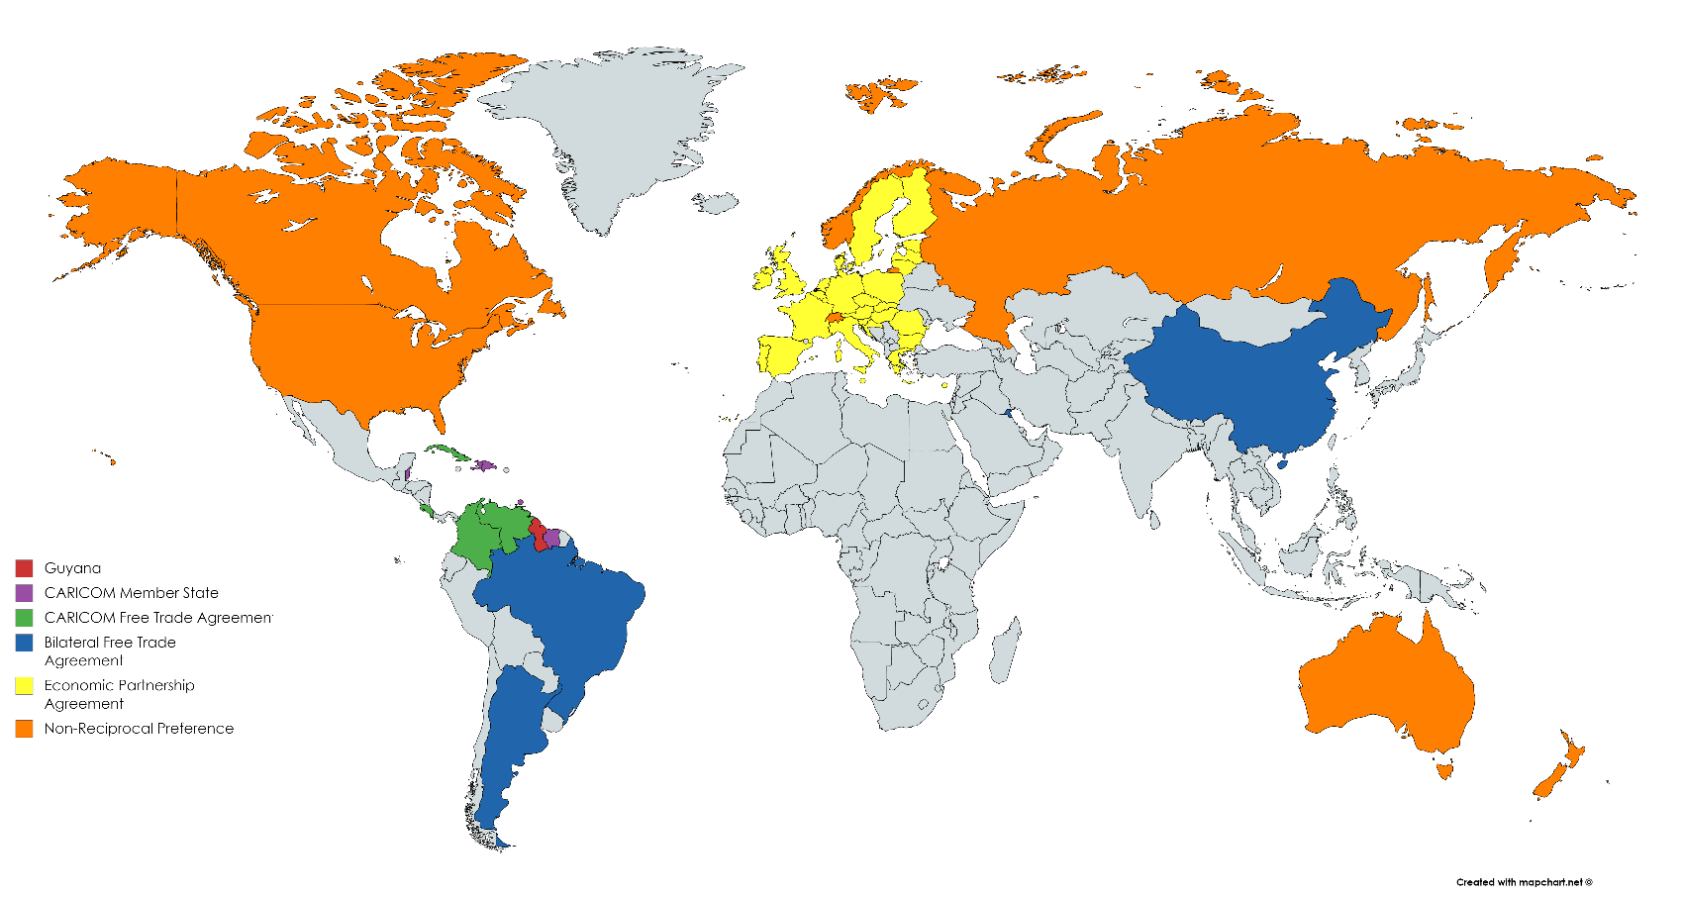
Trade Relationships
Guyana
CARICOM Regional Trade Bloc
CARICOM Free Trade Agreement
Bilateral Trade Agreement
Economic Partnership Agreement
Non-Reciprocal Preference
Notes:
WTO (Not shown)Provides MFN treatment to all trading partners
CARICOM (Purple) = Duty-free access to 14 countries (not all pictured, as the islands are smaller than the map is detailed). Also, standards, competition, contingency measures, intel property, gov. procurement and harmonization of economic policies.
Through CARICOM FTAs (Green) duty free and preferential market access.
Bilateral TA (blue) – Brazil in particular is duty-free, large potential market. China less a market for the NTA ag because S.E. Asia powerhouses in Pine and plantain in particular. Also, currently the vast majority of Carib-China trade is the export of Chinese goods and the import of resources, Timber and bauxite from Guyana. Brazil, Venezuela are Partial scope
Non-Preferential (Orange): Caribbean Basin Trade Partnership Act (CBTPA) with U.S. “transition period” program until 2020 or the date on which the Free Trade Area of the Americas begins. (Trump?) CaribCan with Canada. Also Generalized System of Preference (GSP) with Aus, Can, Japan, NZ, Russia, Switzerland, U.S.
EPA (EU Yellow) is both a FTA and investment partnership. CARICOM members have agreed to certain business/trade standards (ex: Fair competition), financial assistance to governments to enforce this, opens trade/investment in services. Ag goods (X sugar/rice) still have duty-free access.
Benefits of double taxation treaties with the UK, Canada and CARICOM countries

Slide 8
Trade Policy
Removed
Quotas
Voluntary Export Restraints
Price Control Interventions
Licensing Restrictions
Improved and Improving
Competition and Consumer Protection Policy
Sanitary and Phytosanitary Standards
Customs Risk Management
Increased
Export Subsidies
Reduced
Tariffs
Prohibitions
Related Policy
Intellectual Property
Government Procurement
Administrative Procedures
Land-Use
Notes:
Guyana has put substantial effort into liberalization and removed most of its NTB such as negative lists, quotas, and certain licensing restrictions under its ERP.
Improved:
Competition: Competition and Consumer Affairs Commission 2011; has monopoly laws, lacking mergers but drafting legislation
SPS: New law in 2011
Risk Management Unit introduced in 2009, reducing inspections needed, prioritizing at point of exit inspections
Removed:
Were import price quotas on sugar/rice, recently removed.
Increased:
Export Subsidies: Following slide
Reduced:
Tariffs: Next Slide:
Import/export prohibitions on public health concerns, counterfeit money and stamps, opium products, etc.
Export Taxes/Duties : 1.5% non-manufactured, manufactured are free
Other:
Government procurement: Can give up to 10% preference margin to domestic contractors or those using domestically produced goods. Some uncertainty on what qualifies as ‘domestic contractor’. The requirement for hiring at least 80% of local employment is applied equally to domestic and foreign investment projects.
Administrative Procedures: Single Window efforts already underway, need to build organizational capacity to live up to these policies; Lower time needed to process customs paperwork than average LAC country. Problem is in administrative capacity and implementation

Slide 9
Tariffs
Notes:
Tariffs are all ad velorem and all tariff lines are bound.
Duty Free: 9.5%
Under 5: 52.2 %
5-15: 9.3%
15-20: 18.7
Above 20: 10.3%
Coming from a very protectionist previous government, and some of these tendencies do linger. Tobacco and Rum protected.

Slide 10
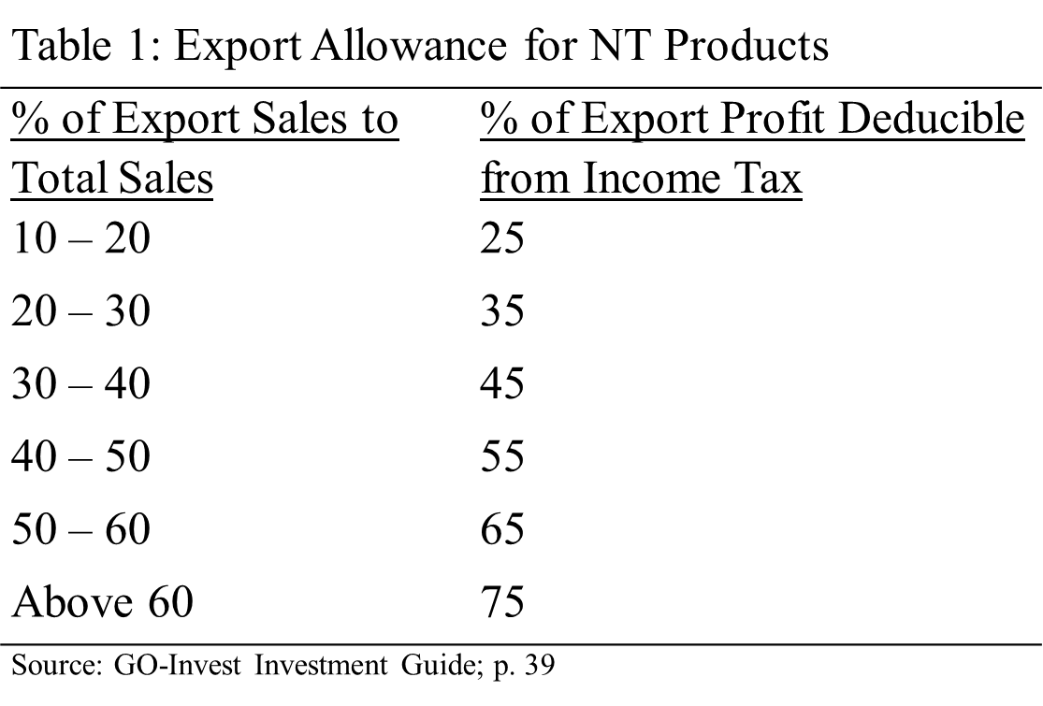
Investment Incentives
Zero-rate on Customs duties for most plant, machinery, raw materials and packaging materials for manufacturing
Unlimited carryover of losses from previous years
Accelerated depreciation on plant and equipment
Full and unrestricted repatriation of capital, profits and dividends
Zero rate of Value Added Tax on specific items
Corporate tax exemptions
Source: GO-Invest, Guyana Revenue Authority
Notes:
Accelerated depreciation allows increased deductions in early years of owning an asset and reduces taxable income.
pending Minister of Finance approval.
Zero-rate on Customs duties for
most plant, machinery, raw materials and packaging materials for manufacturing
Unlimited carryover of losses from previous years
Accelerated depreciation on plant and equipment
Full and unrestricted repatriation of capital, profits and dividends
Under an investment agreement
Zero rate of Value Added Tax on items imported
Exemption for the payment of Excise Tax on items covered
Corporate tax exemptions for up to 5 or 10 years for companies participating in non-traditional economic activities
VAT Exemptions:
Machinery and equipment for land preparation and cultivation, such as hand tools and spare parts for machinery.
Agro-processing machinery and equipment
Some agricultural goods (Raw plantains and pineapples, locally-produced jams and jellies, plantain flour.)
Agro-chemicals (fertilizer, pesticides, fungicides, herbicides and weedicides) and tools (cultivators, scarifiers, loughs, weeders and hoes.)
MUST ALL GO THROUGH INDIV APPROVAL BY _________

Slide 11
Trade Policy Concerns
The Investment Act
Implementation
Better define guidance on incentives
Reduce perception of corruption
Reduce time needed

Slide 12
Agro-Processing Value Chain
Input
Post-Harvest Handling
Production
Harvest
Processing
Packaging
Distribution
Foreign Market
Agrochemical Suppliers
Seed Suppliers
Research and Development Institutions
Farmers
Farmer Associations
Commercial Farms
Machinery Suppliers
Farmers
Farmer Associations
Commercial Farms
Machinery Suppliers
Farmers
Farmer Association
Commercial Farms
Machinery Suppliers
Agro-Processors
Food and Drug Department
Customs and Narcotics Unit
State
Packaging Facilities
Exporters
Agro-Processors
Exporters
Agro-Processors
Shipping companies
Airlines
Wholesalers
Grocers
Food and Beverage Companies
Agro-Processors
Research and Development
Planting
Agrochemical
Application
Production
Harvesting
Sorting
Trimming
Cleaning
Processing
Food Safety Inspection
Packaging
Customs and Narcotics Inspection
Loading
Shipping
Consumption
Further Processing
Re-Export

Slide 13
Value Chain Structure and Dynamics
Transport Shortage
Input
Post-Harvest Handling
Production
Harvest
Processing
Packaging
Distribution
Foreign Market
Abundant Producers
Processor Shortage
Material Shortage
Irregular Air Transport
Distaste for Co-ops
Facility Shortage
Notes:
Transportation and storage potentially occur at the points of the triangle (depending on how fragmented the chains is).
Production: MANY small farmers, have no negotiation power in prices, schedules, etc. Generally have long-standing relationships with middle men/buyers, easy to lose them. Seek to please them.
Packaging: Supplier shortage; anecdotally, $3 per bottle
Irregular Air Transport: Airlines sometimes cancel flights, force exporters to sell on the local market. Lots of lost potential: Planes come full, leave empty. Some can be used for cargo shipments.

Slide 14
Barriers to Accessing Export Markets
Transport Infrastructure
Cold Storage
Electricity Supply
Input
Post-Harvest Handling
Production
Harvest
Processing
Packaging
Distribution
Foreign Market
Economies of Scale
Export Entry Standards
Safety Testing
Material Prices
Traceability
HACCP
Material Quality
Certification
Electricity Supply
Labelling
Notes:
Scale: Currently most farmers own under 2 ha land.
Economies of Scale
Disinclination to Form Groups
Traceability
Certification:
Post Harvest Handling:
Export Entry Standards
Processing
Safety Testing: FDD, to meet safety standards for human consumption
Hazard Analysis and Critical Control Point (HACCP)
Packaging
Packaging
Labelling: Affects raw produce more, but labelling requirements confuse many and are often a cause of rejected shipments.
Packaging: Supply is short – one supplier of glass bottles, and only recently opened. Quality of containers is often poor.
Distribution
PSP
Non-compliance Risks:
Rejection of products at border inspection points
Increased costs if testing/inspection done abroad
Disruption in trade, lost markets
Hazard analysis and critical control points

Slide 15
Processing
Packaging
Distribution
Foreign Market
Processing
Food and Safety Inspection
Packaging
Customs and Narcotics Inspection
Transport to Point of Exit
Loaded
Consumption
System as Designed
Inspection Inefficiencies
Delayed CANU Inspection
Packaging
CANU Inspection
Repackage at Point of Exit
Distribution to Foreign Market
Transport to Point of Exit
Packaging
Quarantine
Transport to Point of Exit
Distribution to Foreign Market
Transport to NAREI
Third Location Quarantine Inspection
Notes:
While the order of the early value chain steps are fairly rigid, we see some confusion as the processed product approaches export. Two complications in particular arose: CANU inspections, which usually occur DURING packaging, were sometimes delayed until the product was at the aiport/wharf. Packages were then opened, examined and repackaged. Naturally, poor repackaging can cause spoilage, damage to the product, the inability to meet entry requirements abroad.
Scenario 2: CANU inspections do not occur at the packaging facility, and require external travel.

Slide 16
SWOT and Market Analyses

Slide 17
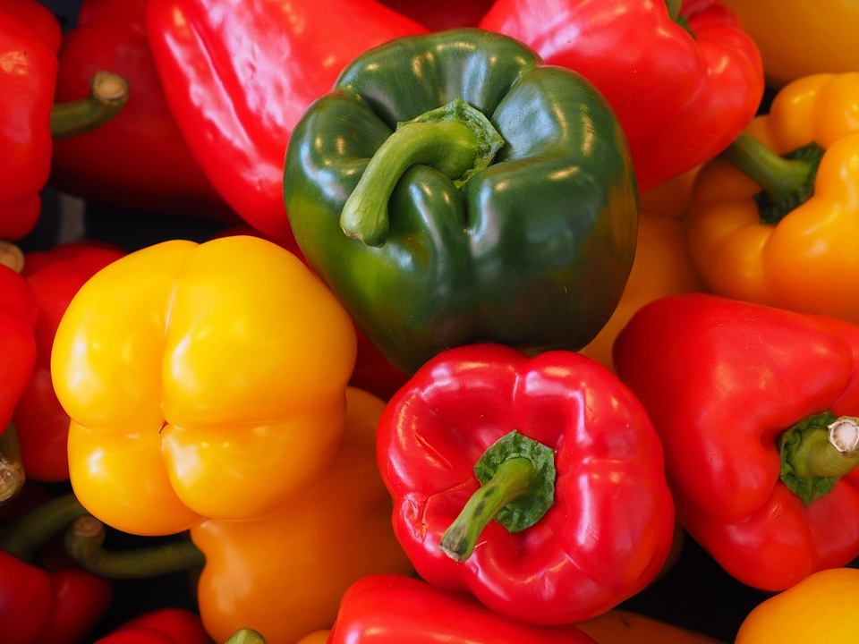
Peppers
Upgrading Opportunities
  Pepper Mash
    U.S.
    CARICOM
  Pepper Sauce
    U.S.-New York City
    Canada- Toronto
  Pepper Flakes
  Dried Pepper
SWOT
Strengths
Low Pesticide Requirements
Low Production Maintenance
Easy Transportation, high density and long shelf-life for processed productions
Opportunities
High demand for processed goods in CARICOM and locally
Niche markets in Diaspora
Carimbola fruit fly eradicated from some regions, under control in most
Weaknesses
Unknown risk of increasing production scale (pests, diseases)
Fresh Pepper is bulky during shipping
Fresh Pepper is prone to rot during shipping
Threats
High competition for fresh peppers
Raw pepper exports to the U.S. prohibited
Notes:
Pepper Mash aking pepper mash made from hot peppers that have been ground, salted, and allowed to ferment with lactobacillus bacteria. The capsaicin naturally present in the peppers, the added salt, and the resulting low pH (high acidity) of the finished product makes it naturally resistant to spoilage. Can be stored for unforeseen natural disaster or shortages (as seen by companies in Jamaica)
US is good market because of general preference shift towards spicy foods, influence of growing Hispanic and latino populations, increase of pepper compounds used in manufacturing. Already had high west Indies population partial to hot peppers. It’s OKAY that MEX dominates fresh pepper trade because Guyana is currently restricted from exporting them. Processed pepper products must meet United States Food and Drug Regulations for low or high acid foods depending on the formulation of the product and must also meet labelling regulations. In addition the exporting firm must submit these products for assessment by the US Food and Drug Department. The fastest growing condiments in the US are hotsauce (5% annuall) and Mexican sauces (3.6% annually) both of which often use pepper mash.
Peru has high quality pepper mash
The EU:European Union Food Import Regulations with respect to packaging and labelling. The greater challenge however is the need to have traceability and HACCP quality systems in place in order to meet the requirements of the major supermarket. Opportunities available to supply the large chains such as Tesco and Sainsbury’s cannot be secure without the implementation of these quality systems.
Hot pepper production in Costa Rica is well organised. The industry revolves around farmer groups undertaking production processing under contractual arrangements with agro-processing firms. The processors obtain low cost loans from the Government’s Development Bank and unlend to farmers at 8% interest rate. In many cases the processors provide the farmers with all the inputs inclusive of seeds, fertilizers and irrigation equipment as well as with technical advice in all areas of production. Farmers essentially act as managers of the farm operation whilst the processors provide financing and business management. Some processors have begun to assist the farmers to establish facilities for processing of pepper mash on behalf of processors. Governments also provide technical assistance in the form of production advice. Additionally farmers have access to national crop Insurance Programme, which carries a premium of 8-8.5% of the price of the crop and protects farmers against natural disasters. Furthermore, farmers are beneficiaries of a national Social Security, Medical, Disability, and Retirement Programme.

Slide 18
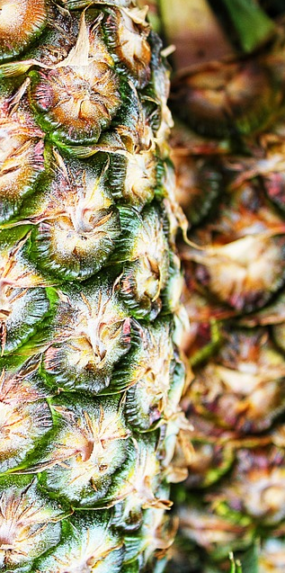
Pineapple
Upgrading Opportunities
  Chunks/Slices
    USA
  Juice/Concentrates
    CARICOM Tourism Markets
    EU
    USA
SWOT
Strengths
Transports well
Soil in coastal land naturally at low-end of pineapple pH requirements
Consistent tropical climate
Opportunities
High demand for processed goods
Fragmented juice market
CARICOM Demand (Tourism)
Neighboring market (Suriname)
Long-term Opportunities in Organic
Weaknesses
Sensitive to water fluctuations and planting patterns
Threats
Discriminatory import barriers to some CARICOM markets
High competition within CARICOM (CRI)
Notes:
CARICOM: Despite fact that most Central American and Caribbean nations do produce pineapples, often in substantial amounts, some still import pineapple juice. Though small markets, largely driven by tourism, these markets can be potential points of entry into exports, as they have CARICOM benefits. Preserved pineapple has less market potential for this region.
Chunks/Slices Market: Competition PHL 18% THA 46% Kenya 6.5%) MarketUSA 33%
Juice (Competition diverse: CRI, THA ~20%), main market is the EU (~50%) and USA (17%) 2015 OEC WTO

Slide 19
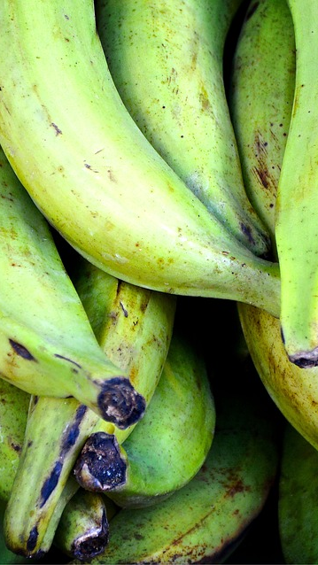
Plantain
Upgrading Opportunities
  Plantain Chips
    North and Central America
  Plantain Fries
    North America
SWOT
Strengths
Grows well in newly-cleared land
Consisted tropical climate
Transports well
Opportunities
High market demand for plantain chips
Weaknesses
Black and Yellow Sigatoka outbreak across many regions
Moka Disease outbreak
Current low production
Threats
Low demand due to disease outbreak
Lost market opportunities and connections due to outbreak
High competition within CARICOM and Brazil

Slide 20
Value Chain Solutions

Slide 21
Value Chain Solutions
Power Imbalances
Facility Needs
Human Capital
Notes:
Transportation services
Packaging services
Airport scanner
Storage Facilities
- Cold storage at the airport – Exporters park and run refrigerated trucks all night
Skill Gap: How to handle Black and yellow Sigatoka/Moka
- Knowledge is there, there is a precise time to treat, but there is not the extension capacity
Streamline and professionalize CANU
- Timing, misinformation (Pivotal stakeholder couldn’t say when they do their examination)
- Handling of produce
7. Small-scale farmers should work under contract for anchor firms. Costa Rica pepper farmers do this.
Cooperatives won’t work unless there’s outside talent with accountability brought in.

Slide 22
Value Chain Solutions
Power Imbalances
Transportation services
Packaging services
Economies of Scale in Farming
Anchor Firms
Hired Management for associations
Notes:
Transportation services
Packaging services
7. Small-scale farmers should work under contract for anchor firms. Costa Rica pepper farmers do this.
Cooperatives won’t work unless there’s outside talent with accountability brought in.

Slide 23
Value Chain Solutions
Facility Needs
Airport
Scanner
Cold Storage
Packaging Facilities
Distant Regions
Notes:
Airport scanner
Storage Facilities
- Cold storage at the airport – Exporters park and run refrigerated trucks all night
7. Small-scale farmers should work under contract for anchor firms. Costa Rica pepper farmers do this.
Cooperatives won’t work unless there’s outside talent with accountability brought in.

Slide 24
Value Chain Solutions
Human Capital
Skill Gap: Black and Yellow Sigatoka/Moka
Streamline the Customs and Narcotics Unit
Notes:
Skill Gap: How to handle Black and yellow Sigatoka/Moka
- Knowledge is there, there is a precise time to treat, but there is not the extension capacity
Streamline and professionalize CANU
- Timing, misinformation (Pivotal stakeholder couldn’t say when they do their examination)
- Handling of produce

Slide 25
Value Chain Solutions
Trade Policy
Free Zone
Inward Processing Regime
Refining the Investment Act
Notes:
Free Zone: Currently discussion of Export processing Zones
No export requirement, only reaching certain standards.
Must incorporate local value chain/suppliers! Local suppliers supplying a certain percentage (40%) of their sales to the Free Zone can be incorporated into the regime, get benefits.
To encourage investment outside of coastal plains, which are prone to flooding (Ex: excessive flooding in 2005 resulted in losses equivalent to 60% of GDP), can reduce initial investment requirements (assets) and differentiated taxes to businesses located outside of the Georgetown area.
The Inward Processing Regime allows goods to enter national customs territory with suspension of import duties and subject to a guarantee deposit.
Goods must be re-exported within the time-limits, after undergoing, processing, repair, reconstruction, installation or assembly.
The goods must be re-exported within a non-renewable period (Ex: one year) .

Slide 26
Questions

Slide 27
Appendices

Slide 28
Sources
Cross Study Analysis
Literature Review:
● Ministry of Agriculture
● Library of Congress country compilation
● FAOLEX
JSTOR, Google Scholar, UMD Library Search Engine
Post-2005
IDB, Caribbean Export Promotion Agency
Notes:
LIT REVIEW: Google Scholar, JSTOR and University of Maryland Library search engines, journals published after 2005 were examined.
agricultural GVCs
Guyanese agriculture
Trade Policy
Inter-American Development Bank, to avoid duplication and build on previous research. T
Policy documents from the GUY Ministry of Agriculture’, the U.S. Library of Congress country compilation and the Food and Agricultural Organization’s agricultural law database, FAOLEX.
MACRO: trade, employment, labor productivity, Foreign Direct Investment (FDI), and exports and imports; from the United Nations Commodity Statistics Database (UNCOMTRADE), the World Bank, FAOSTAT and the Ministry of Finance and Ministry of Agriculture of Guyana.
BUSI ENV: The World Bank (WB) Enterprise Surveys, WB Doing Business Indicator, WB Logistics Performance Index
AG CASE STUDIES: Growing Guides, Market Surveys, Market Entry Requirements, from both international sources Technical Centre for Agricultural and Rural Cooperation (CTA) and MoA/New GMC

Slide 29
Sources
Preliminary Value Chain Analysis
Macroeconomic Analysis:
● United Nations Commodity Statistics Database (UNCOMTRADE)
● the World Bank
● FAOSTAT
● Ministry of Finance
● Ministry of Agriculture
Business Environment:
● WB Doing Business Indicators
● WB Enterprise Surveys
● Logistics Performance Index
● Transparency International Global Corruption Index
Key Agricultural Good Case Studies:
● Growing Guides (GMC, USAID, CTA)
● Market Surveys (GMC, CEA)
● Market Entry Requirements (CTA, New GMC)
Notes:
Technical Centre for Agricultural and Rural Cooperation

Slide 30
Sources
Primary Data Collection
● Making Global Value Chains Work for Development
By Taglioni and Winkler
Notes:
LIT REVIEW: Google Scholar, JSTOR and University of Maryland Library search engines, journals published after 2005 were examined.
agricultural GVCs
Guyanese agriculture
Trade Policy
Inter-American Development Bank, to avoid duplication and build on previous research. T
Policy documents from the GUY Ministry of Agriculture’, the U.S. Library of Congress country compilation and the Food and Agricultural Organization’s agricultural law database, FAOLEX.
MACRO: trade, employment, labor productivity, Foreign Direct Investment (FDI), and exports and imports; from the United Nations Commodity Statistics Database (UNCOMTRADE), the World Bank, FAOSTAT and the Ministry of Finance and Ministry of Agriculture of Guyana.
BUSI ENV: The World Bank (WB) Enterprise Surveys, WB Doing Business Indicator, WB Logistics Performance Index
AG CASE STUDIES: Growing Guides, Market Surveys, Market Entry Requirements, from both international sources Technical Centre for Agricultural and Rural Cooperation (CTA) and MoA/New GMC

